Slide 1
A ‘Pink Wave’ in 2018?

Slide 2
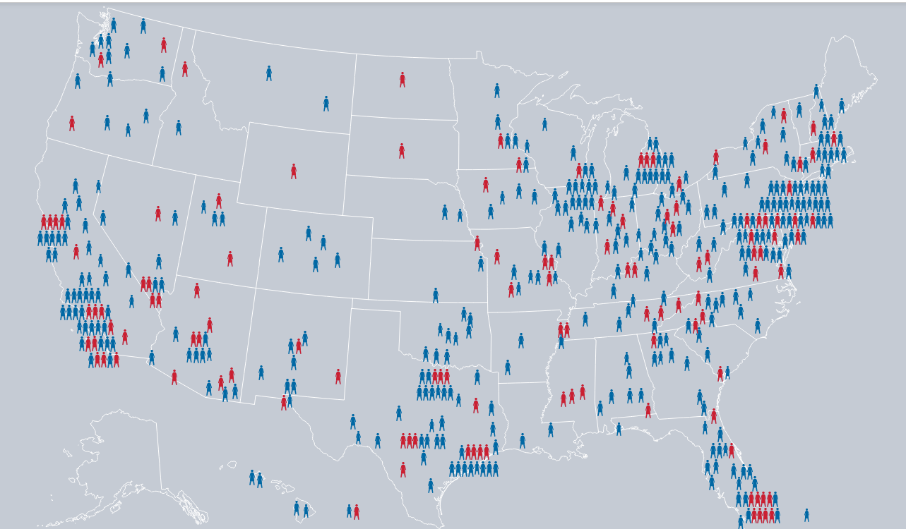

Slide 3
Record numbers of women running
U.S. House of Representatives
475 women have filed
Up from previous record of 298 in 2012
U.S. Senate
42 women filed, perhaps up to 47
Up from 40 in 2016
Governors
50 filed, perhaps 60+
Running in 35 of 36 states electing governor in 2018
Up from record of 34 in 1994

Slide 4
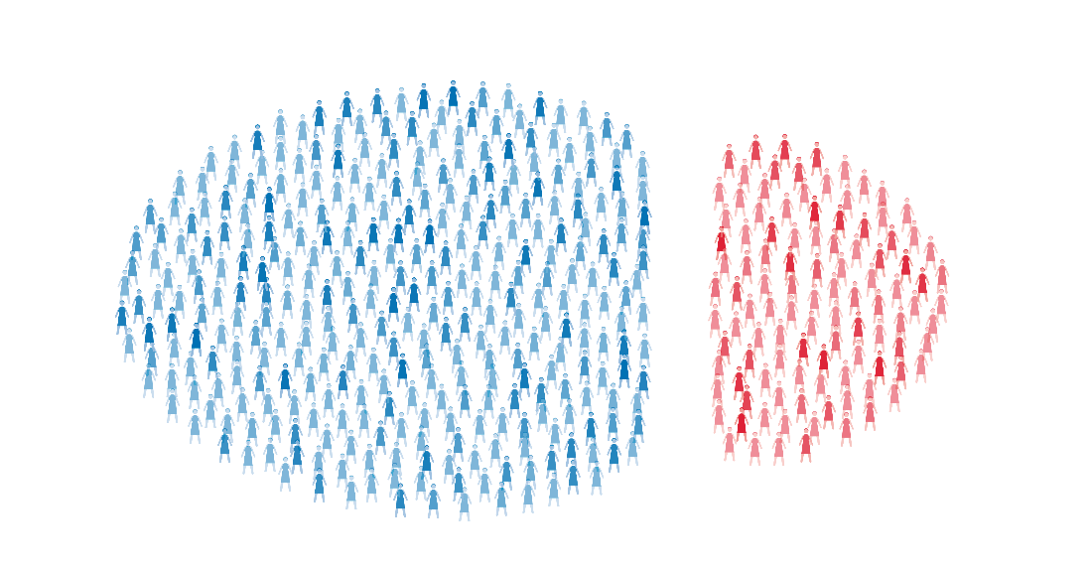
Pink Wave is mostly blue

Slide 5
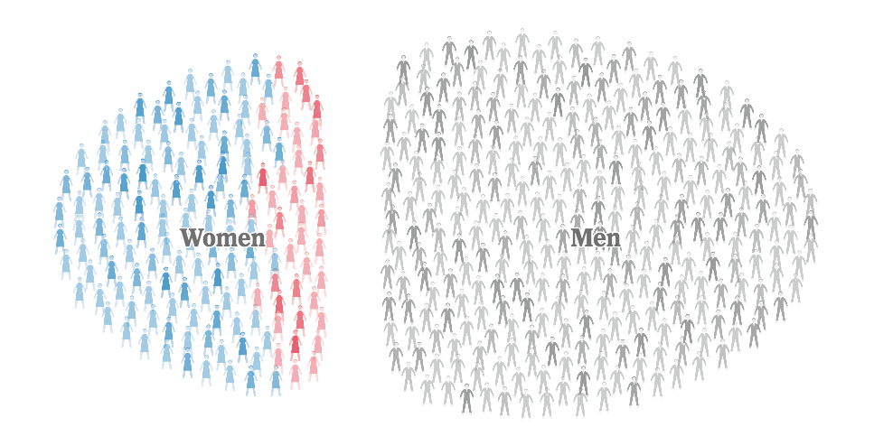
Women still swamped by men

Slide 6
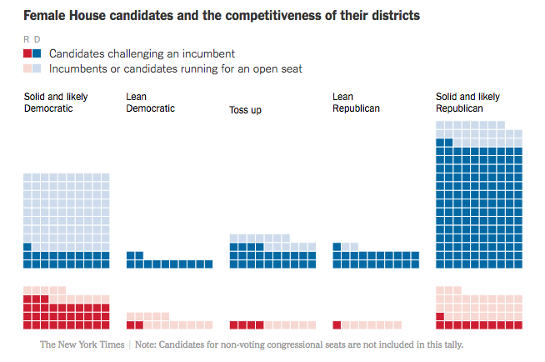

Slide 7
Oddities and Realities - House
47 women are challenging male incumbents in a party primary
55 women are challenging women incumbents in a primary
82 primaries have more than one woman running
26 woman v. woman races
Four women are running for U.S. Senate in Arizona – two Democrats and two Republicans

Slide 8
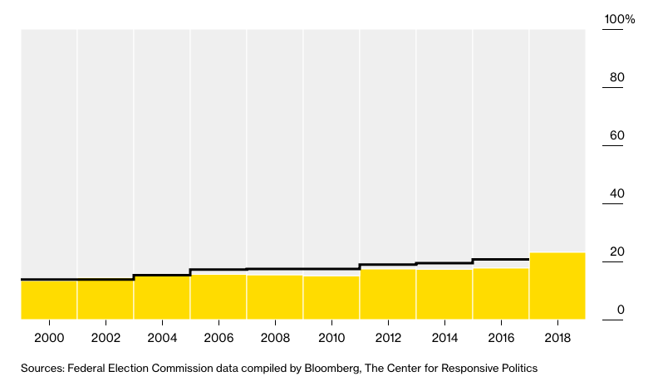
Women’s increase is proportional

